Slide 1
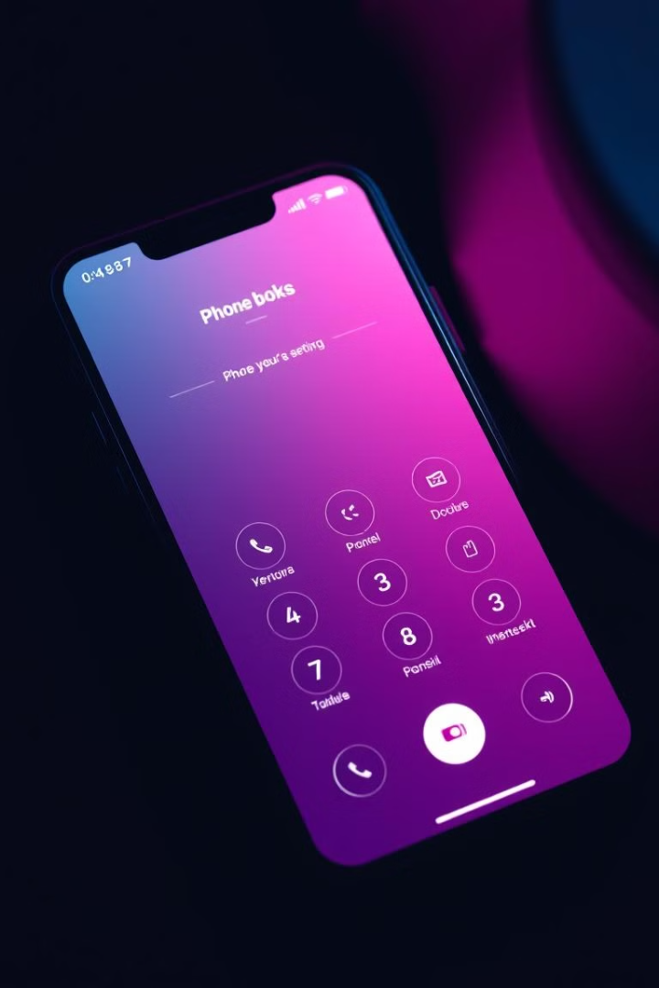

Efficient Phone Book Management System
This presentation introduces our comprehensive Phone Book Management System, designed to streamline contact management and enhance user efficiency. Built using C++, the system offers a range of features for managing contacts, including adding, retrieving, searching, sorting, and deleting entries. It also leverages advanced algorithms for efficient data retrieval and sorting, enhancing the overall user experience.
by Omar Elbatran

Slide 2
Overview of the System
User Interface
Data Storage
Search and Sort Algorithms
The user interface is designed to be intuitive and user-friendly. It allows users to perform all the necessary operations easily. It includes a simple menu-driven structure for navigation.
Contacts are stored efficiently in a structured database for fast retrieval and manipulation. This ensures that the system can handle large numbers of contacts without compromising performance.
The system employs advanced search and sorting algorithms, such as binary and jump search, as well as Merge Sort and Quick Sort, for efficient retrieval and organization of contact data.

Slide 3
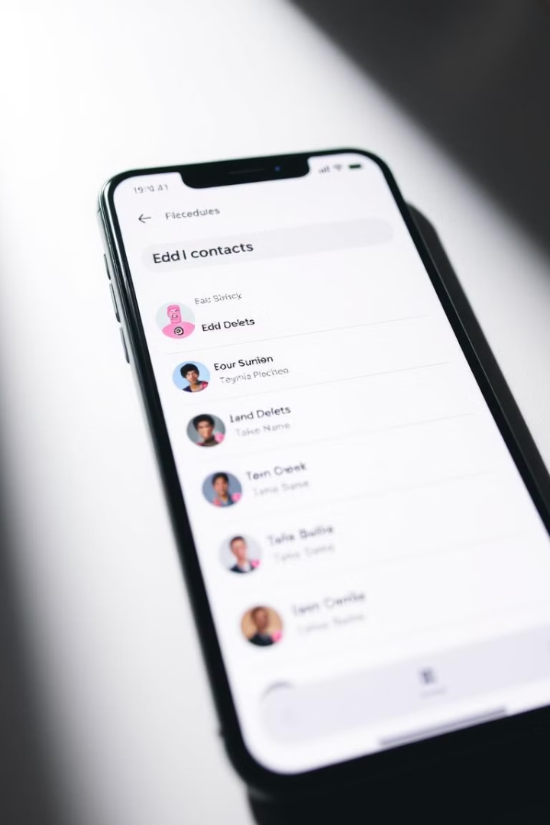
Key Features
Contact Addition
Contact Retrieval
Users can easily add new contacts with their details, such as name, phone number, address, and email. The system validates the input to ensure data accuracy.
Users can quickly retrieve specific contacts using a variety of methods, including name, phone number, and email. The system employs efficient search algorithms for fast retrieval.
Contact Deletion
Contact Modification
Users can delete existing contacts using simple commands. The system removes contacts from the database permanently, ensuring data integrity.
Users can edit existing contact information as needed. The system allows users to modify any field associated with a contact.

Slide 4
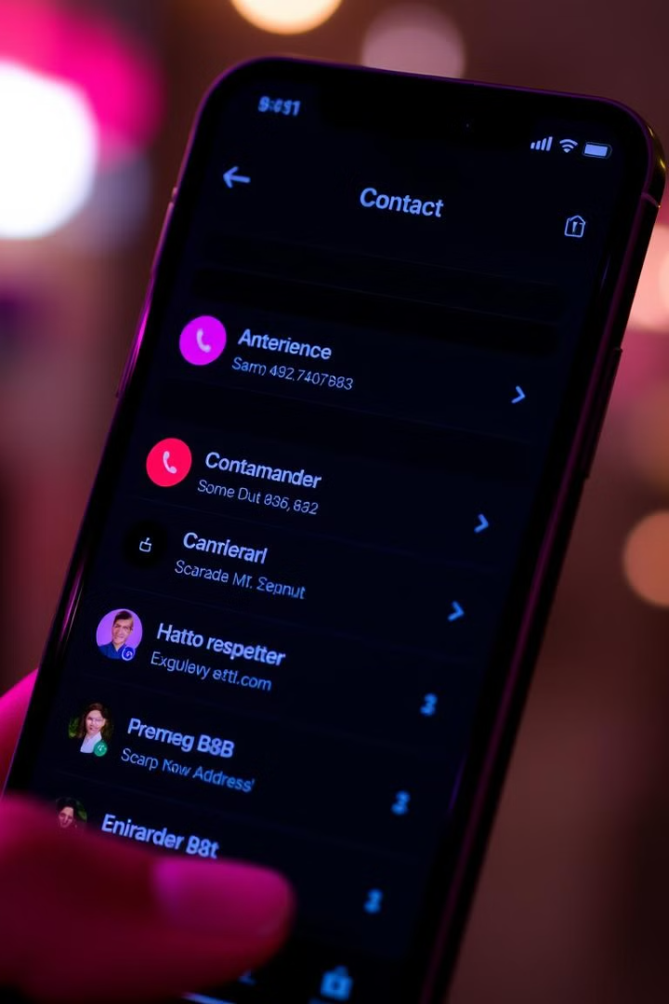
Efficient Contact Management
Contact Storage
Data Validation
The system utilizes a structured approach for storing contact information, ensuring data integrity and efficient retrieval. It can store contact data in multiple formats, including CSV, JSON, or a custom database.
The system validates input data to ensure accuracy, preventing errors and maintaining data quality. It ensures that contact information is entered correctly and in a consistent format.
Backup and Recovery
The system provides backup and recovery options to safeguard contact data against unexpected issues. It allows users to create backups of their contact data and restore them if needed.

Slide 5




Searching and Sorting Capabilities
Efficient Search
Advanced Sorting
Filtering Options
The system incorporates both linear and binary search algorithms for efficient contact retrieval. Linear search is used for simple searches, while binary search provides faster results for larger datasets.
The system offers various sorting options, such as alphabetical order by name, by phone number, and by city. It allows users to organize contacts based on their specific needs.
Users can filter contacts based on specific criteria, such as city, contact type, or a combination of factors. This helps them quickly locate relevant contacts within the database.

Slide 6
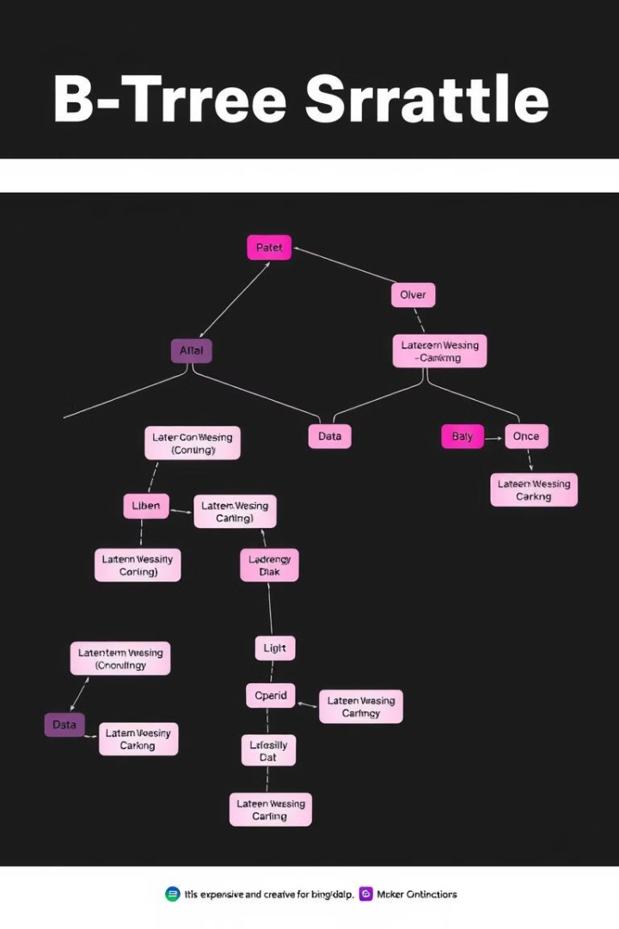
Partial B-Tree Implementation
1
Data Organization
The system leverages a Partial B-Tree implementation for organizing contacts by city. It divides the database into smaller, indexed segments for faster retrieval of contacts based on location.
2
City-Based Search
Users can easily search for contacts based on their city. The system uses the B-Tree structure to efficiently navigate through the database and locate contacts within a specific city.

Slide 7




Advanced Algorithms Used
Binary Search
1
Used for efficient retrieval of contacts based on a sorted data set, allowing for quick location of specific entries within the database.
Jump Search
2
A variation of binary search that can be used for searching large datasets, making it suitable for scenarios where the database contains a large number of contacts.
Merge Sort
3
Used for sorting the contact list efficiently, allowing for quick and organized arrangement of contacts based on specific criteria.
Quick Sort
4
Provides an alternative to Merge Sort, leveraging a divide-and-conquer approach for sorting contacts quickly and efficiently.

Slide 8
Real-World Use Cases
Business Contacts
1
Managing business contacts effectively is crucial for networking and relationship building. The system enables efficient organization and retrieval of business contacts for seamless communication.
Family Contacts
2
Keeping track of family members, their phone numbers, addresses, and birthdays is essential. The system helps organize family contacts for easy access and communication.
Event Planning
When planning events, managing guest lists, contact information, and RSVPs is vital. The system assists with gathering and organizing contact information for successful event coordination.
3

Slide 9
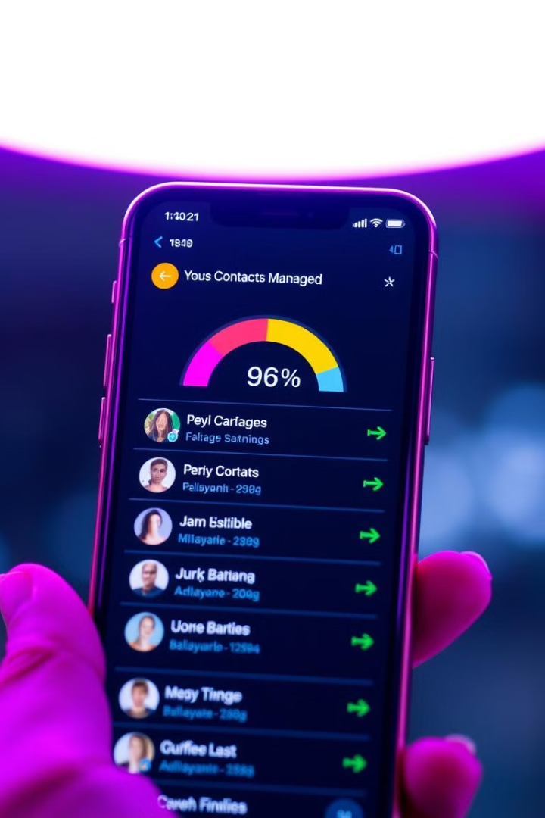
Conclusion: Enhanced Contact Management
This presentation highlighted the features and benefits of our robust Phone Book Management System. With its user-friendly interface, efficient algorithms, and advanced features, the system offers a streamlined solution for managing contacts effectively. The system is applicable in various real-world scenarios, enhancing communication and productivity for individuals and businesses alike.

